Slide 1


Patient admissions dashboard
Rachel Atkinson
Collective Analytics

Slide 2
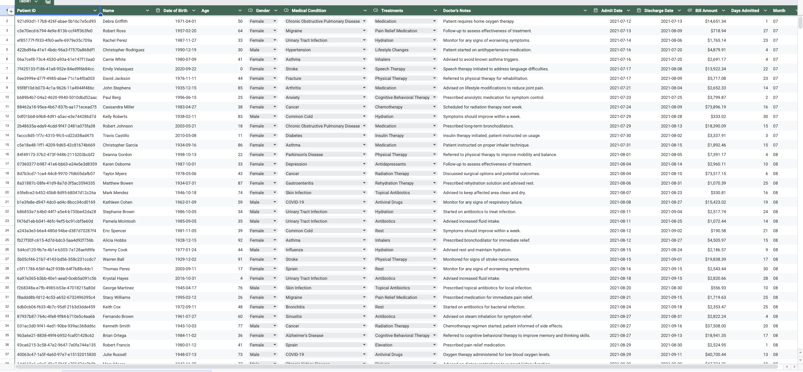
Patient admissions dataset

Slide 3
Descriptive statistics
Using Descriptive Statistics to find Information the Data Set.
Minimum Billing Amount: $102.55
Maximum Billing Amount: $99,769.22
Average Billing Amount: $9,589.32
Total Billing Amount: $9,464,654.08
Average Length of Stay: 15.6
25th Percentile Billing Amount: $1,580.81
75th Percentile Billing Amount: $12,554.03

Slide 4
Function Lookups
Using Function Lookups to Find Information About the Data Set.
Find the Medical Condition for Emily Vasquez: Stroke
Find the Billing Amount for Patrick Larsen: $44,789.00
Find the Days Admitted for Patient ID: 06386535-8EC1-4462-AA34-BF43786E1F68: 25
Find the treatment for Medical Condition: Stroke
Find the Doctors Notes for Patient Taylor Myers: Discussed Surgical Options and Potential Outcomes

Slide 5
Probability
Using Probability To Find the Estimation Percentage Regarding the Data:
Calculate the Probability of the Medical Condition of a Common Cold being Admitted Based on this data: 3.95%
Calculate the Probability of Billing Amount Exceeding $10,000.00: 29.66%

Slide 6
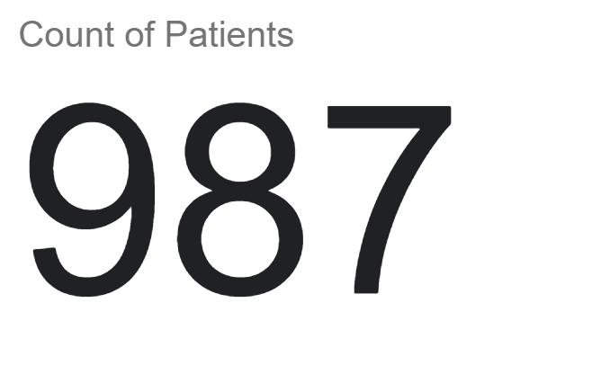
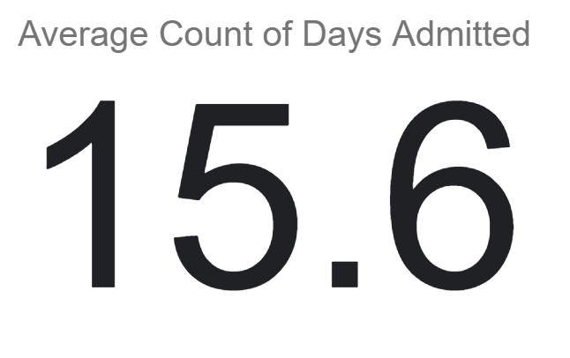
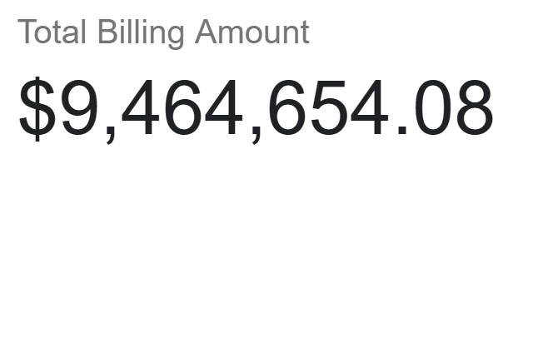
KPIS: Count of patients, average count of days admitted, and total billing amount

Slide 7
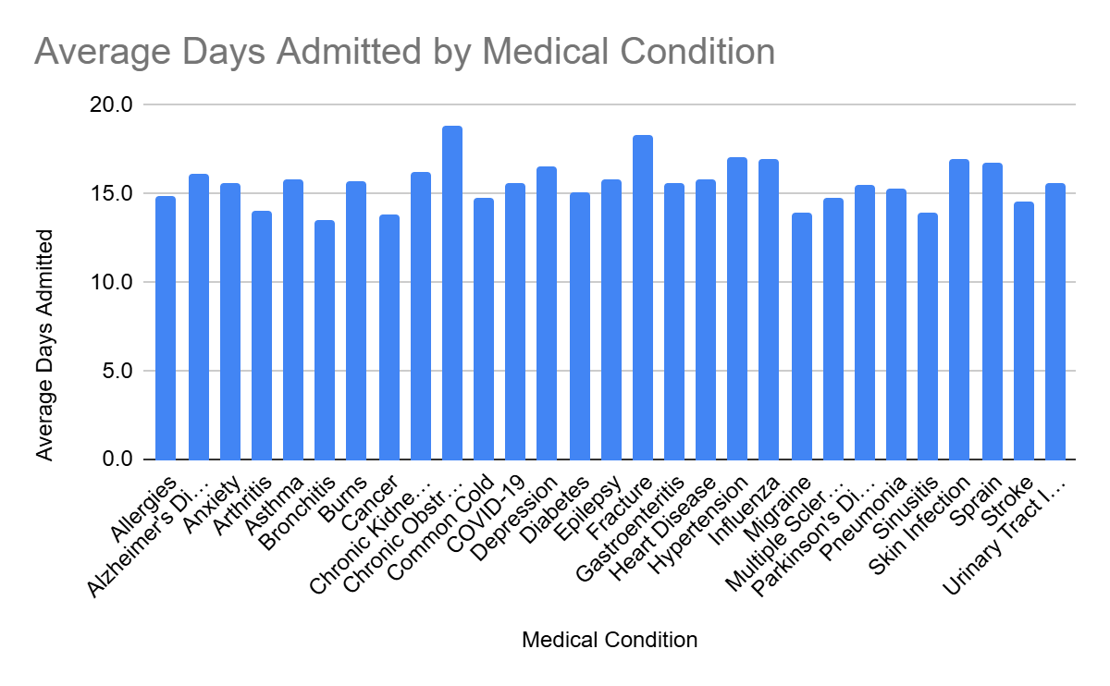
What is the average length of stay for patients with a specific diagnosis?

Slide 8
How does patient age impact length of stay? Regression Analysis
Regression Analysis: Predicting Length of Stay Based on Age Range
Dependent Variable Used: Days Admitted
Independent Variable Used: Age
Slope Coefficient: Shows that Length of Stay is expected to increase based on Age holding all other factors constant.
Standard Error of Slope: Shows that the Standard of Error is low which means this is more reliable and certain
R-Squared : Shows that the model may not fit the data well and other variables may need to be brough in.
Analysis: This Data Analysis reveals a positive correlation between age and length of stay. This suggests that increased age is associated with a slight increase of length of stay. This suggests that age does impact length of stay. For a further analysis, other independent variables may be brought in such as sex and medical condition.

Slide 9
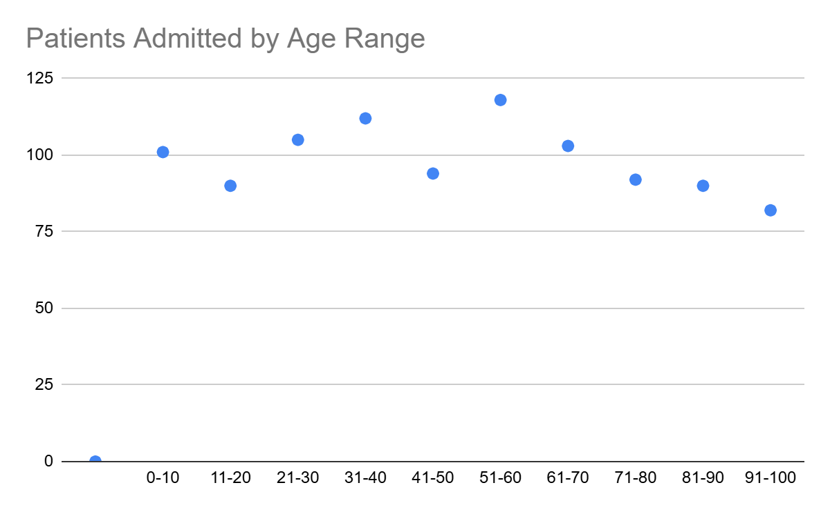
How does patient age impact length of stay? Regression Analysis Graph

Slide 10
Predicting hospitalization costs based on medical conditions-hypothesis
Hypothesis on Billing Amount Across Different Medical Diagnoses
Is there a Significant Difference in Average Billing Amount Between Medical Conditions: Cancer and Diabetes?
Null Hypothesis: There is not a difference between Billing Amount for Cancer and Diabetes
Alternative Hypothesis: There is a Difference between Billing Amount for Cancer and Diabetes.
Using a Two-Tailed T Test, The P-Value is Significant and we Fail to Reject the Alternative Hypothesis.

Slide 11
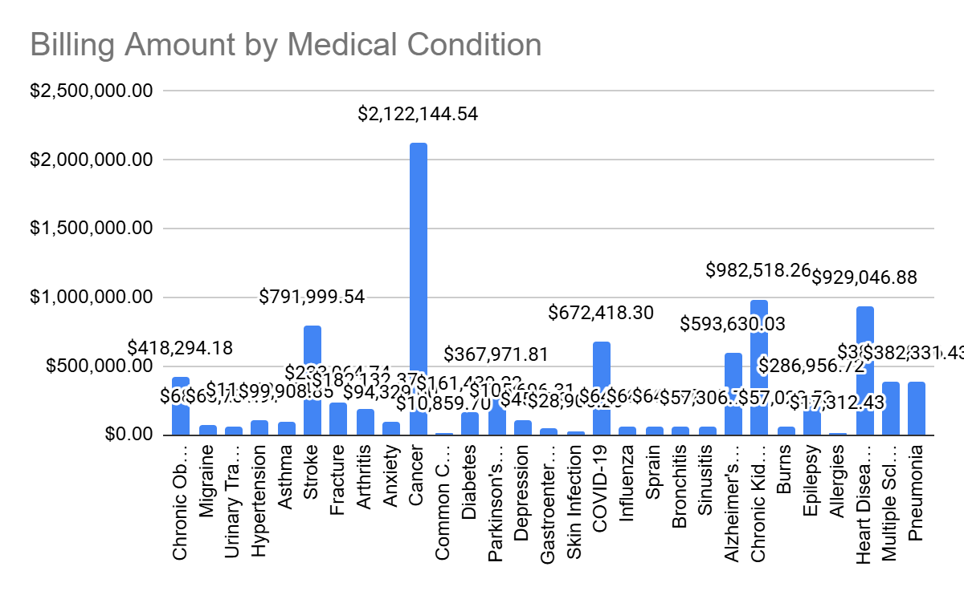
Predicting hospitalization costs based on medical conditions

Slide 12
Patient admissions data analysis
Based on this Dataset, Data Analysis was Performed to Answer Questions Regarding Patient Admissions.

